Slide 1

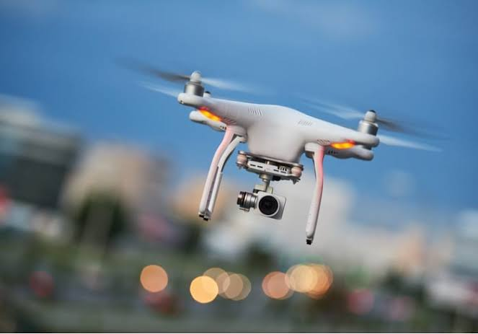
IIC Last Mile Delivery in a Multi-storey Building
CLASSIFICATION : Robotics and Drones
Team MemberS: Ravaishmi Gupta (LEADER)
Pratyush Priyansh
Vishakha Gupta
Vikas Tiwari
ChanDRA Maul Sinha
Anamika Pandey

Slide 2
PrOBLEM STATEMENT : Last Mile Delivery in a Multi-storey Building
1.)Delivery is the heart of E-commerce.
2.)Companies depend heavily on delivery personals.
3.)On time delivery.
4.)last minute delivery.
5.)delivery while travelling.
6.)Can be used in medical fields.

Slide 3
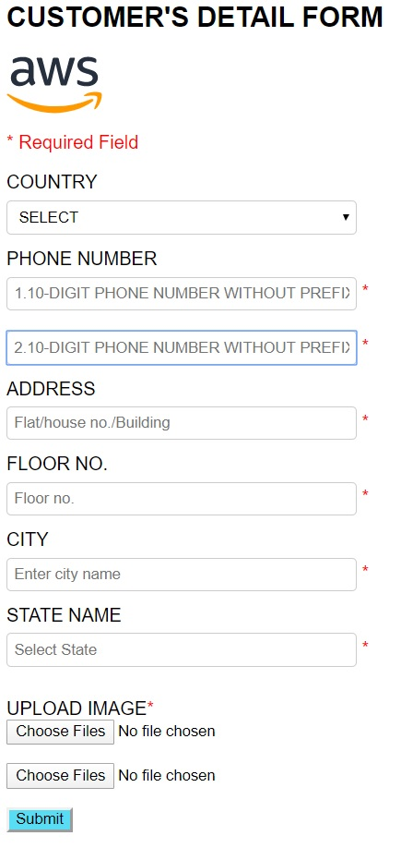

Slide 4
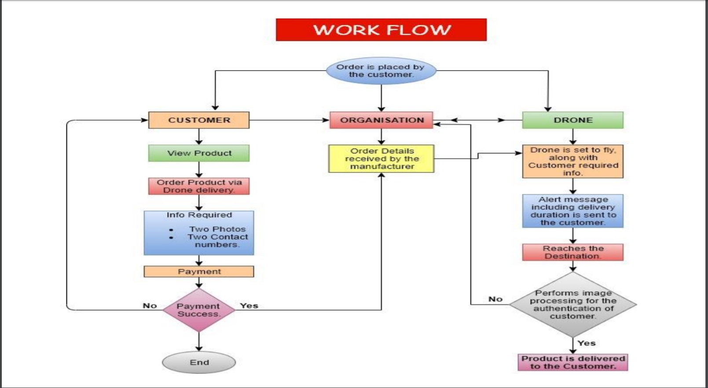
How it is done ?

Slide 5
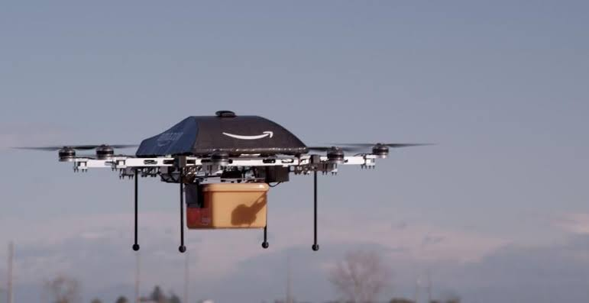
KEY POINTS:
Use OF Exact positioning to be delever
WI-FI technology for reaching the exact floor in flat.
Identification of authenticated customer using image processing.
Delivery of the product via reel system.

Slide 6
Identification of authenticated customer using image processing.
AFTER SUCESSFULLY REACHING THE DESIRED FLOOR THE DRONE STARTS IMAGE PROCESSING FOR THE CONFIRMATION AND AUTHENTICATION OF CUSTOMER.
ONCE THE RESULT IS POSITIVE THE ORDER DROPSDOWN.

Slide 7
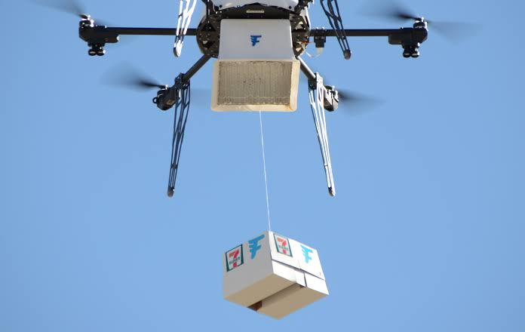
Delivery of the product via pulley system.
AFTER POSITIVE RESULT FROM IMAGE PROCESSING THE DESIRED ORDER ATTACHED WITH PULLEY DROPS DOWN .
THE CUSTOMER DETACHES THE ORDER .
THE PULLEY REELS BACK AFTER A PROGRAMMED TIME INTERVAL.

Slide 8
USED:
HARDWARE:
SOFTWARE:
RASPBERRY PI
MPU6050
DC MOTOR
CAMERA MODULE
IC L293D
PYTHON
HTML

Slide 9
Points of consideration:
The pollution will constantly decrease due to the reduce in delivery automobiles.
In case of any emergency medical equipments can be provided in a very short duration of time.
Flexibility of the customer in terms of time.
Technical jobs will be increased.
Disabled or old age people living at higher ground like 15th or 16th floor would not have to take any kind of pain to take delivery.

Slide 10
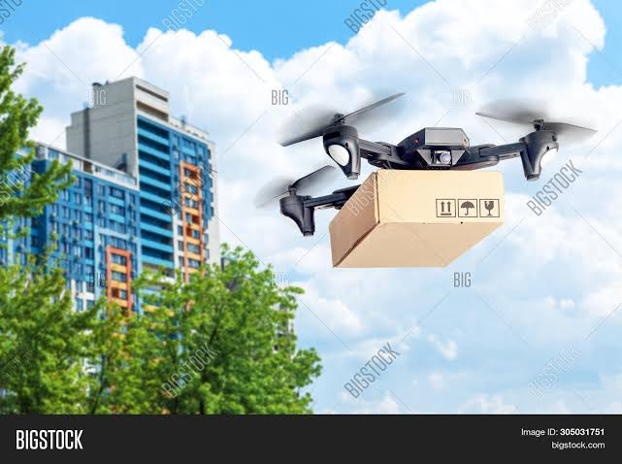
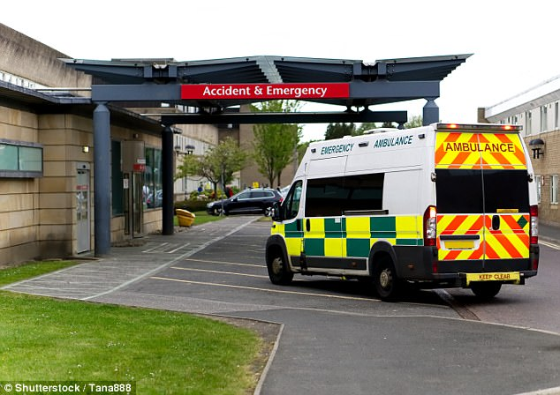
SCENARIO

Slide 11


